Slide 1
The Battle of Neighborhoods
Onkar Sardesai
November 2019

Slide 2
Contents
Introduction
Data
Chicago Public Schools
Chicago Crime Data
Methodology
Results
Top 15 violent areas
Top 10 community
Popular Venues

Slide 3
Introduction
One of the main problems when ones move to a new city is where to find a good neighbourhood .
This work will be focused on analysing and visualizing some community of Chicago.
A good community will be ones with low rate of crime, healthy schools and high number of public schools.
Aims:
provide valuable insights about the life of a good community in Chicago (SOUTH LAWNDALE)
Support people to make decision when they want to move to Chicago.
The main business accompanied in this work is what are the best areas in Chicago in term of safety and schools as well as what are different type of venues in those area that one can expect for.

Slide 4
Data
Chicago Public Schools
This dataset shows all school level performance data used to create CPS School Report Cards for the 2011-2012 school year.
This dataset is provided by the city of Chicago’s Data Portal.
For this work I only use a snapshot of this dataset downloaded from here
A detailed description of this dataset and the original dataset can be obtained from the Chicago Data Portal.

Slide 5
Methodology
Stage 1 - Business Understanding: the main goal is to search for where is the best area in Chicago in term of safety and schools.
Stage 2 - Analytic Approach
First identify which are the most violent areas in Chicago based on the Crime Data
Next the areas are visualized on the map so users can be aware of those.
Last, community with high number of schools which is ideally to live is presented to the users.
Stage 3 - Data Requirements
The data required for this work is described in the Data section.
Those datasets were download and then stored in the IBM Db2 database for latter usage.
Venues information provided by FourSquare will be used also to give users an overview of their future ideal community.

Slide 6
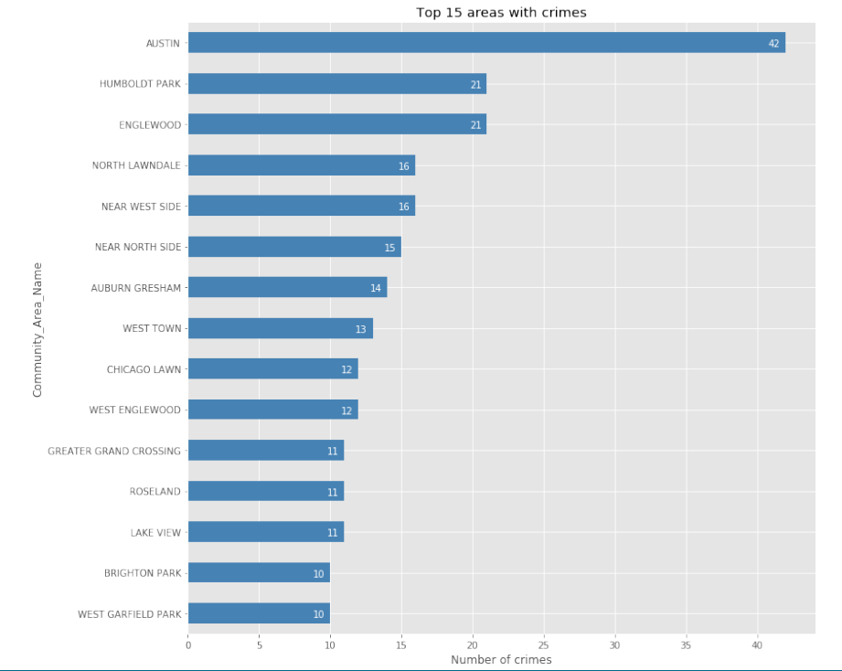
Results Top 15 violent areas in Chicago

Slide 7
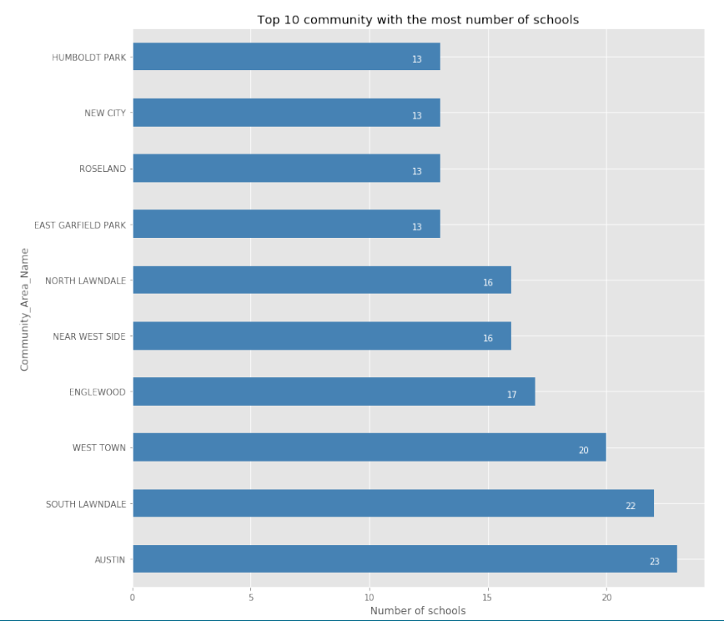
Results Top 10 community with good schools

Slide 8
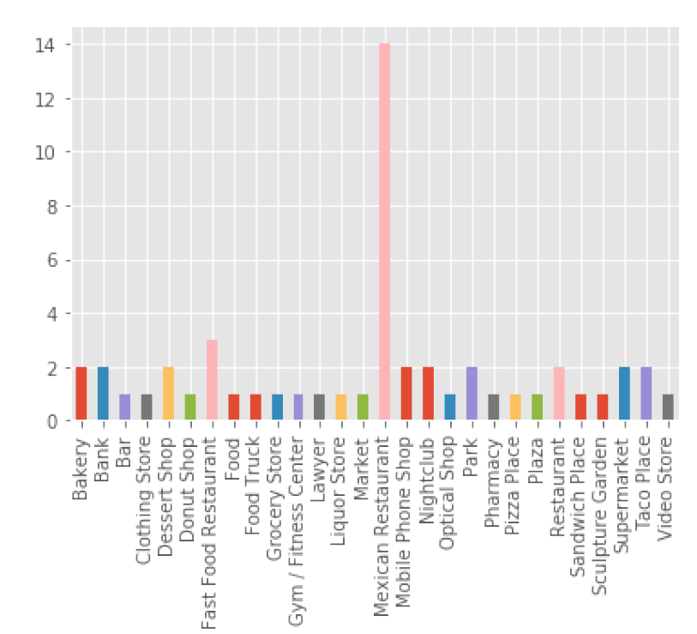
Results Popular Venues in SOUTH LAWNDALE

